Slide 1
Getting started in bioinformatics
Adam Kim
2019 – 08 – 12
Twitter: @atomadam2

Slide 2
Outline
Diversity in Bioinformatics
Deciding what you want/need
What do I need to start?
R
Getting Data for a Project
Scripting
Visualization
Experimental Design

Slide 3
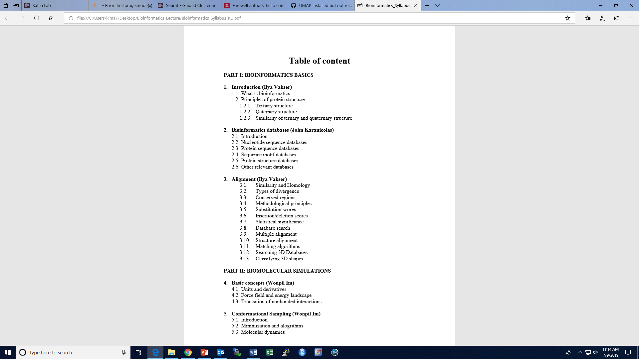
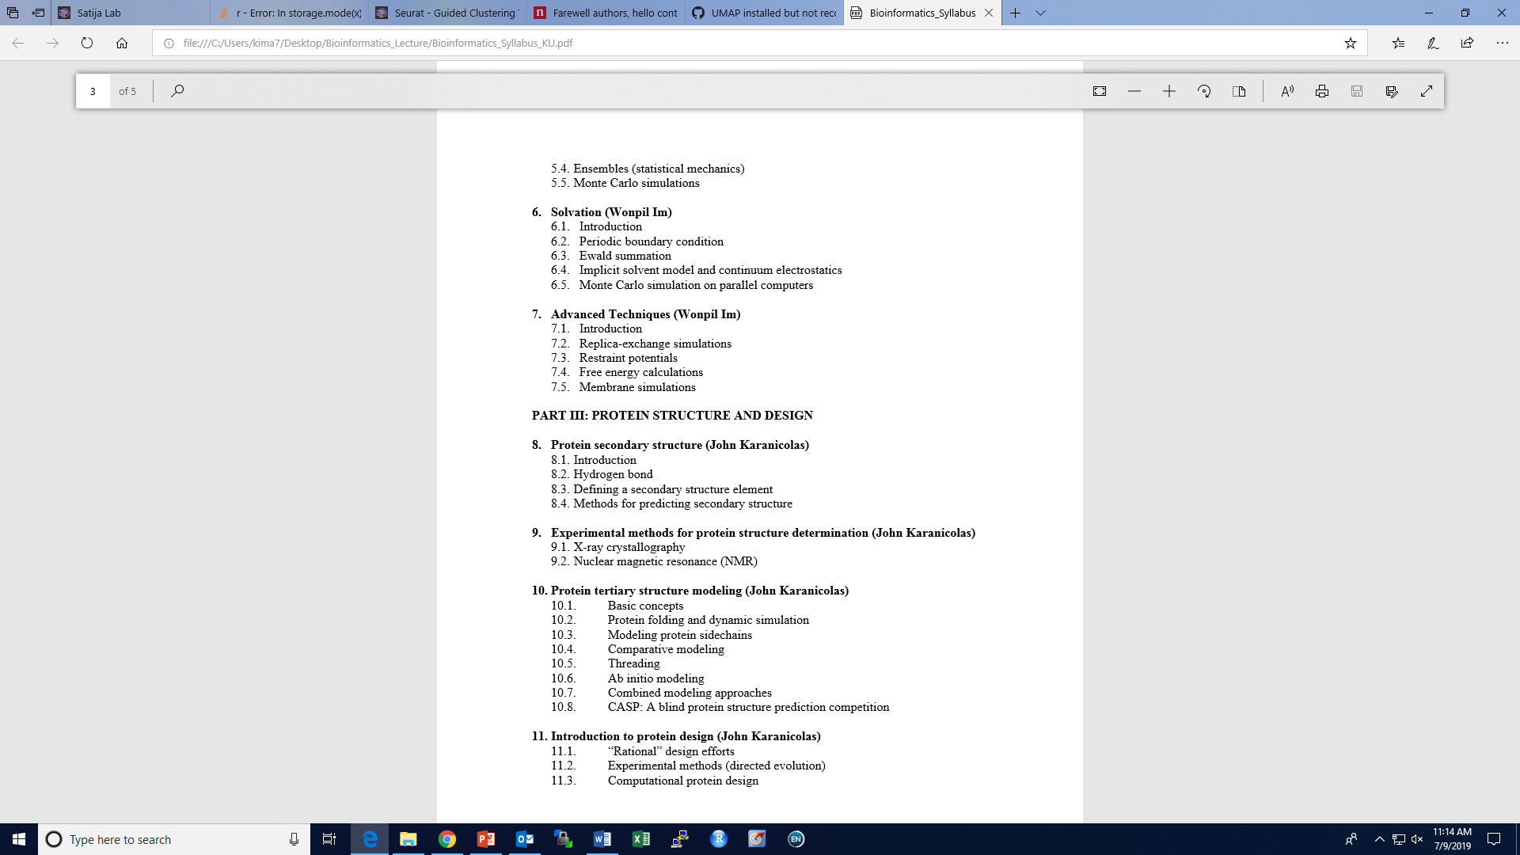
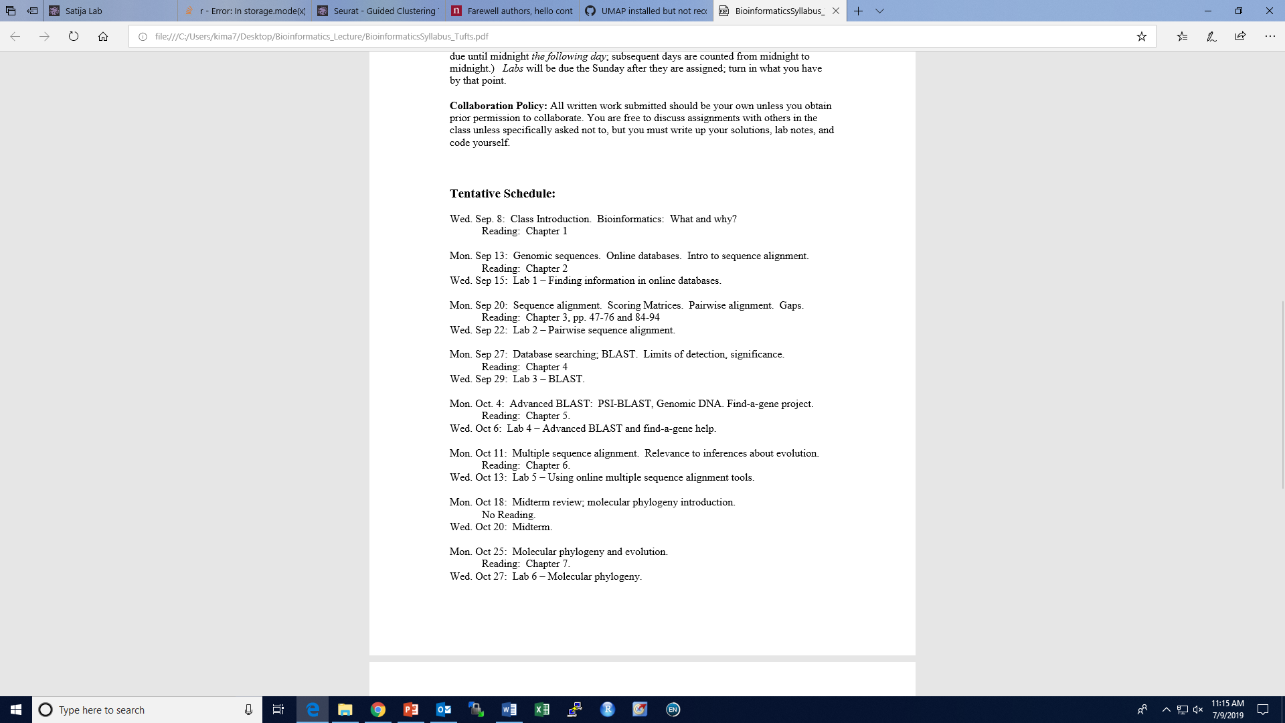
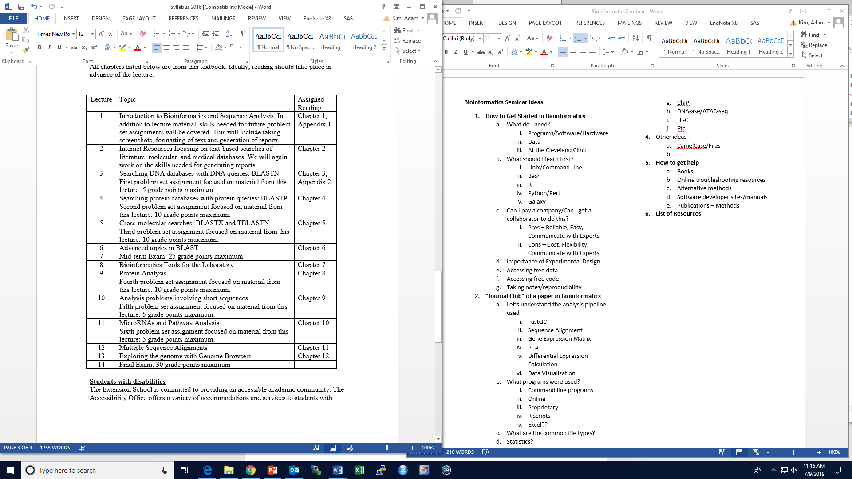
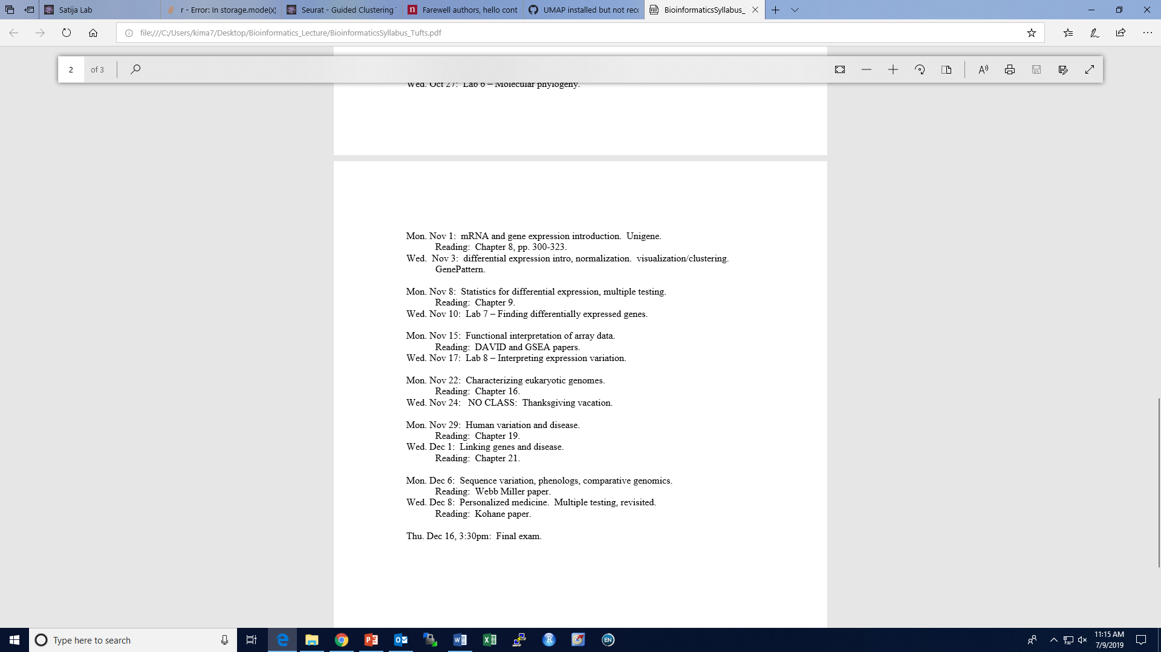
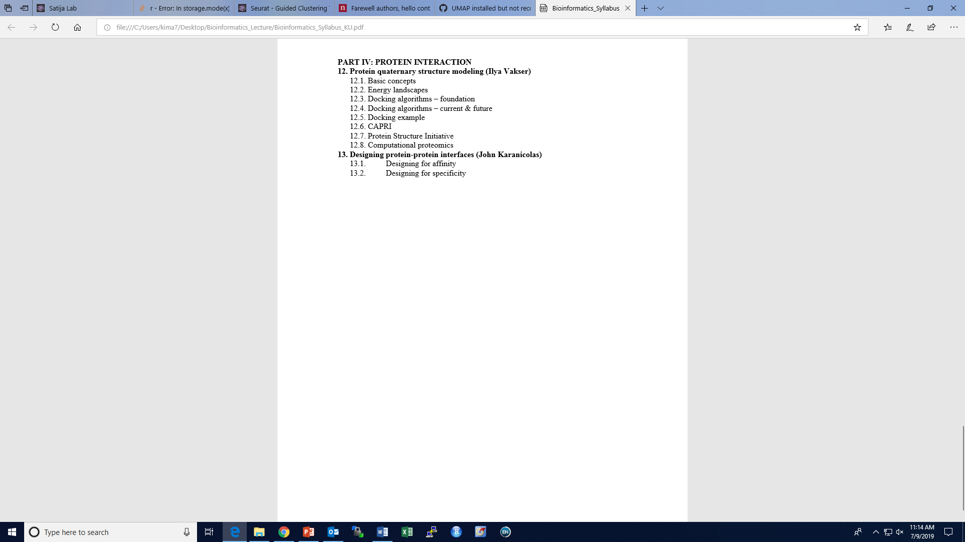

Slide 4
Downstream Analysis?
Microscopy?
Epidemiology?
Health Informatics?
Statistics?
Data Visualization?

Slide 5
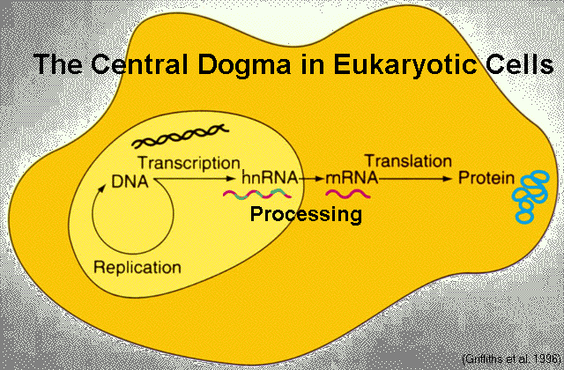
Bioinformatics and the Central Dogma

Slide 6
Bioinformatics and the Central Dogma

Slide 7
Bioinformatics and the Central Dogma

Slide 8
Bioinformatics and the Central Dogma

Slide 9
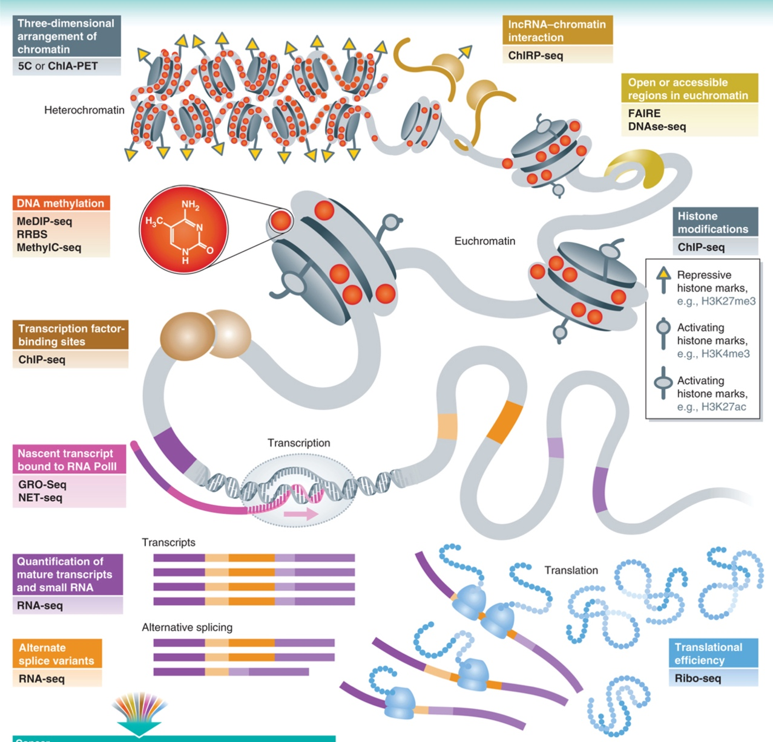
Variations in Sequencing

Slide 10
Bioinformatics and the Central Dogma

Slide 11
Questions to ask yourself
What do you want?
What tools/skills do I need?
How do I learn these skills?
How do I get started?

Slide 12
Questions to ask yourself
What do you want?
What tools/skills do I need?
How do I learn these skills?
How do I get started?
Is it too time consuming?
Can I pay someone to do this?
Can I collaborate with someone to do this?
Will I be confident enough to show people?
Can I do this alone?

Slide 13
Sequencing: Files and Programs

Slide 14
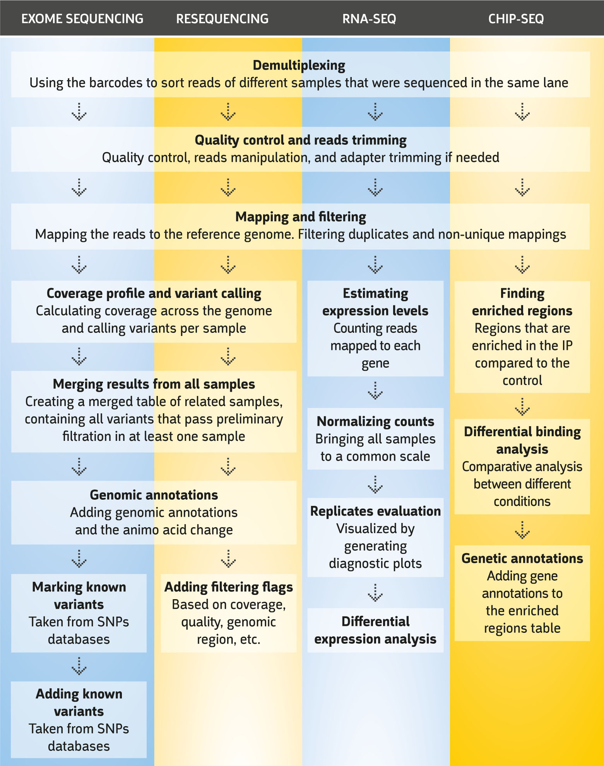
Sequencing: Files and Programs

Slide 15
Sequencing: Files and Programs
UNIX/BASH
R

Slide 16
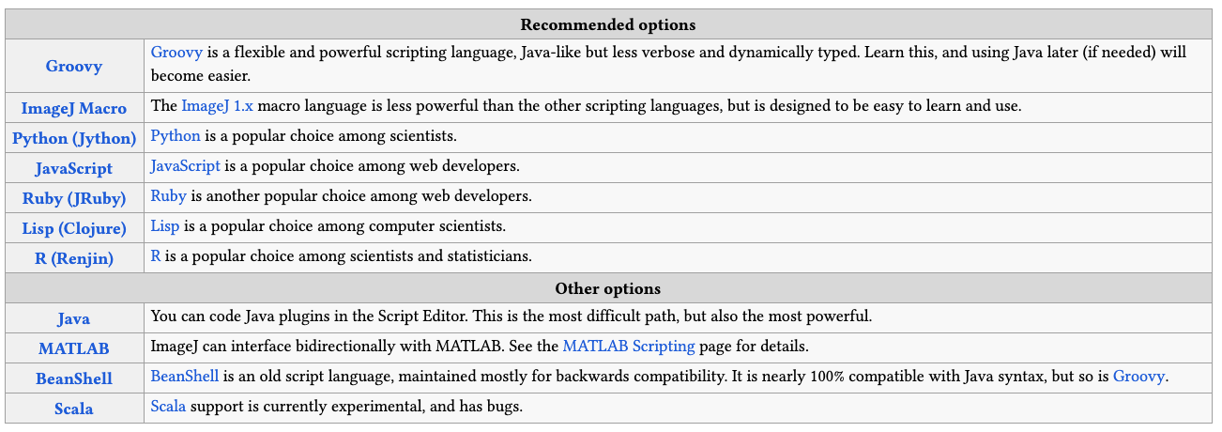
Microscopy and ImageJ
From imagej.net

Slide 17
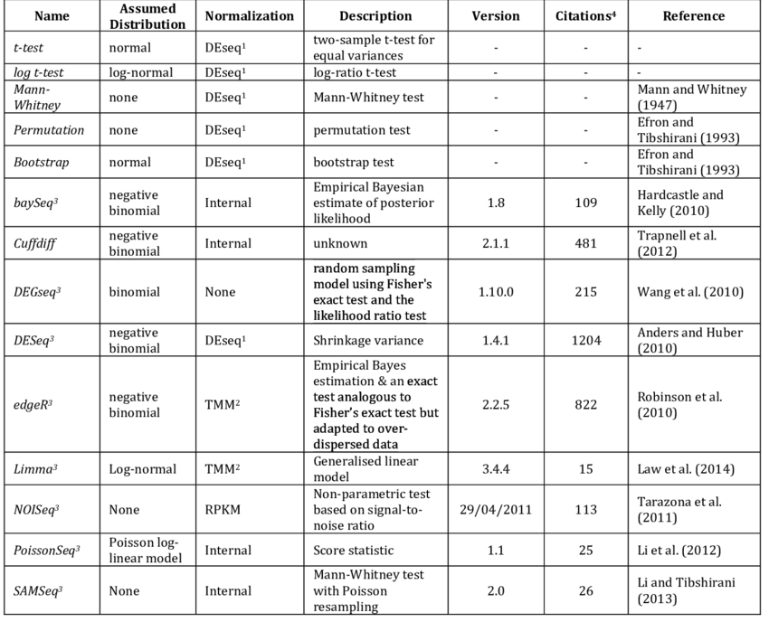
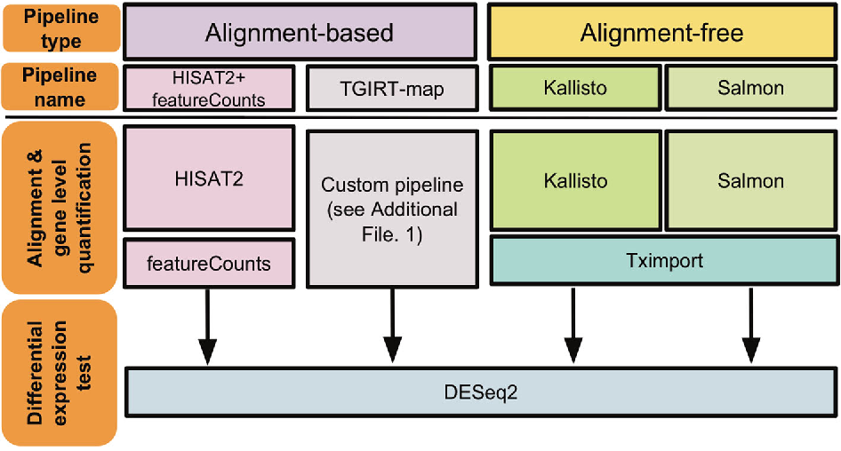
Software

Slide 18
What Now?
Decide what you want to learn
Get a book
Get a project
Get data
Get started

Slide 19
What Now?
Decide what you want to learn
Get a book
Get a project
Get data
Get started

Slide 20
What Now?
Decide what you want to learn
Get a book
Get a project
Get data
Get started

Slide 21
What Now?
Decide what you want to learn
Get a book
Get a project
Get data
Get started
A suggestion
Coming up with a project
What that would look like

Slide 22
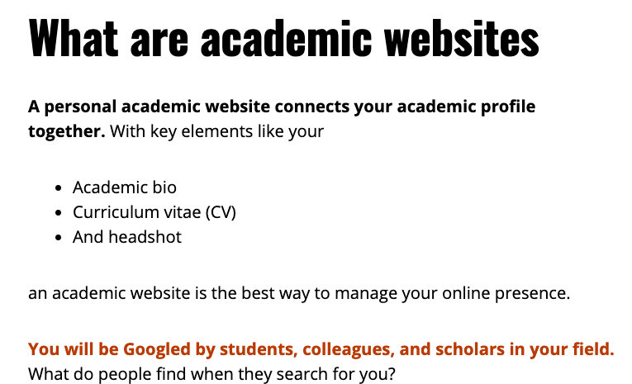
R

Slide 23
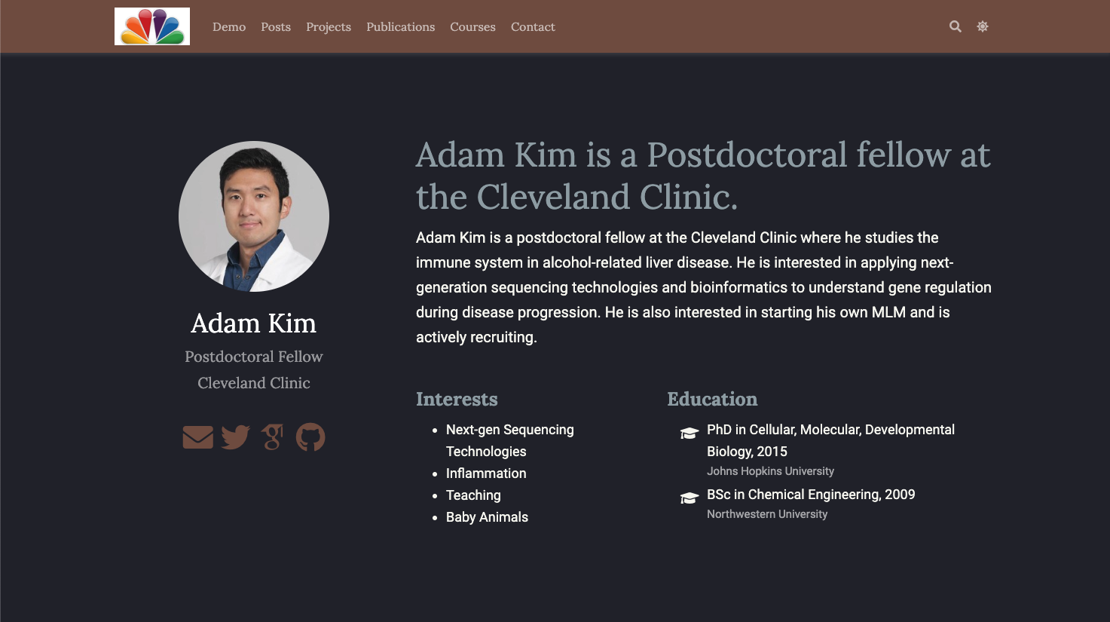
Using R to make a website

Slide 24
Using R to make a website
TO DO:
Install R
Install Rstudio
Install packages
Word of Advice
Use a personal computer

Slide 25
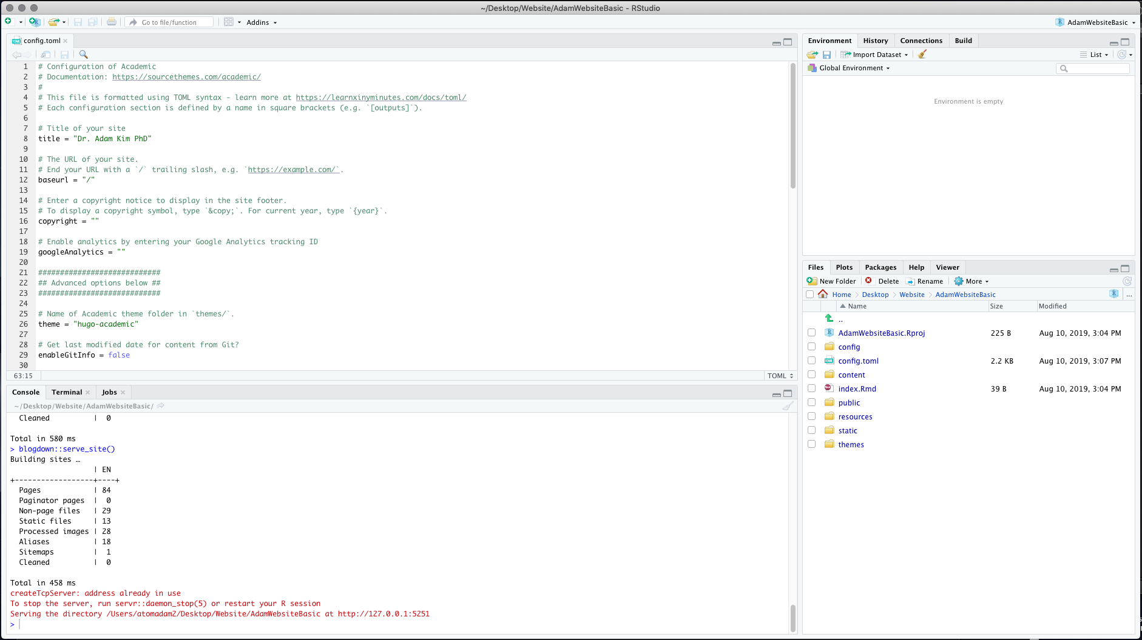
R

Slide 26
R

Slide 27
R

Slide 28
R

Slide 29
R

Slide 30
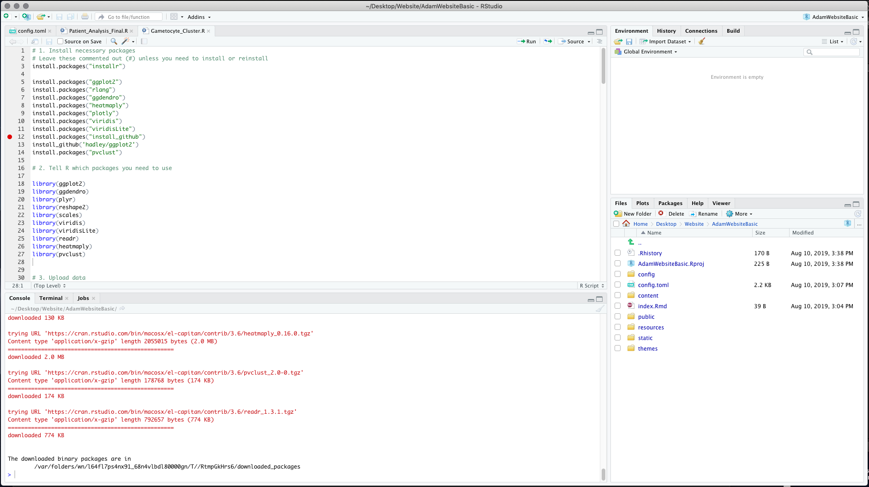
R

Slide 31
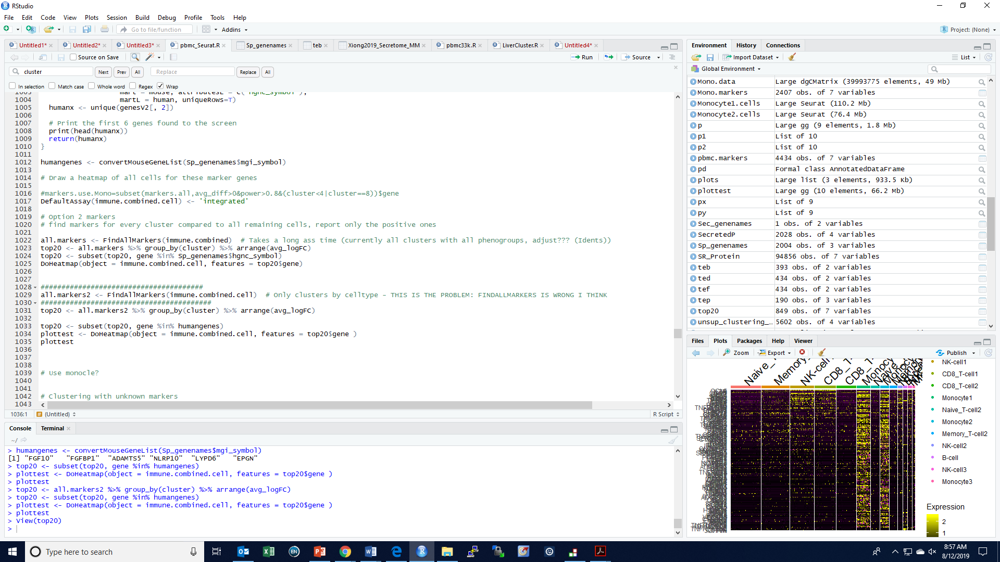
R
More picture of R in action

Slide 32
Sequencing: Files and Programs
UNIX/BASH
R

Slide 33
Sequencing: Files and Programs
Both of these types of data are inconsistently available from publications
UNIX/BASH
R

Slide 34
Sequencing: Files and Programs
Both of these types of data are inconsistently available from publications
UNIX/BASH
In fact – The most frustrating part of my job is dealing with
data
R

Slide 35
Sequencing: Files and Programs
UNIX/BASH
R
But what if you want to do something new?

Slide 36

Sequencing: Files and Programs
UNIX/BASH
R
But what if you want to do something new?

Slide 37
What should I do?
Do you have a project in mind?
NO
YES
Does it involve Sequencing Data?
Learn R
Learn Unix
NO
NO
NO
YES
Maybe?
Do you need raw reads?
Do you want to manipulate data?
Learn Unix
and Python/Perl
YES
YES

Slide 38
What should I do?
Do you have a project in mind?
Pay someone to do this?
NO
YES
OR?
Does it involve Sequencing Data?
Learn R
Learn Unix
NO
NO
NO
YES
Maybe?
Do you need raw reads?
Do you want to manipulate data?
Learn Unix
and Python/Perl
YES
YES

Slide 39
Raza ahmad 2016 Principle, analysis, application and challenges of next-generation sequencing: a review
500 hours /min
~40mb/min
= 1200gb/min

Slide 40
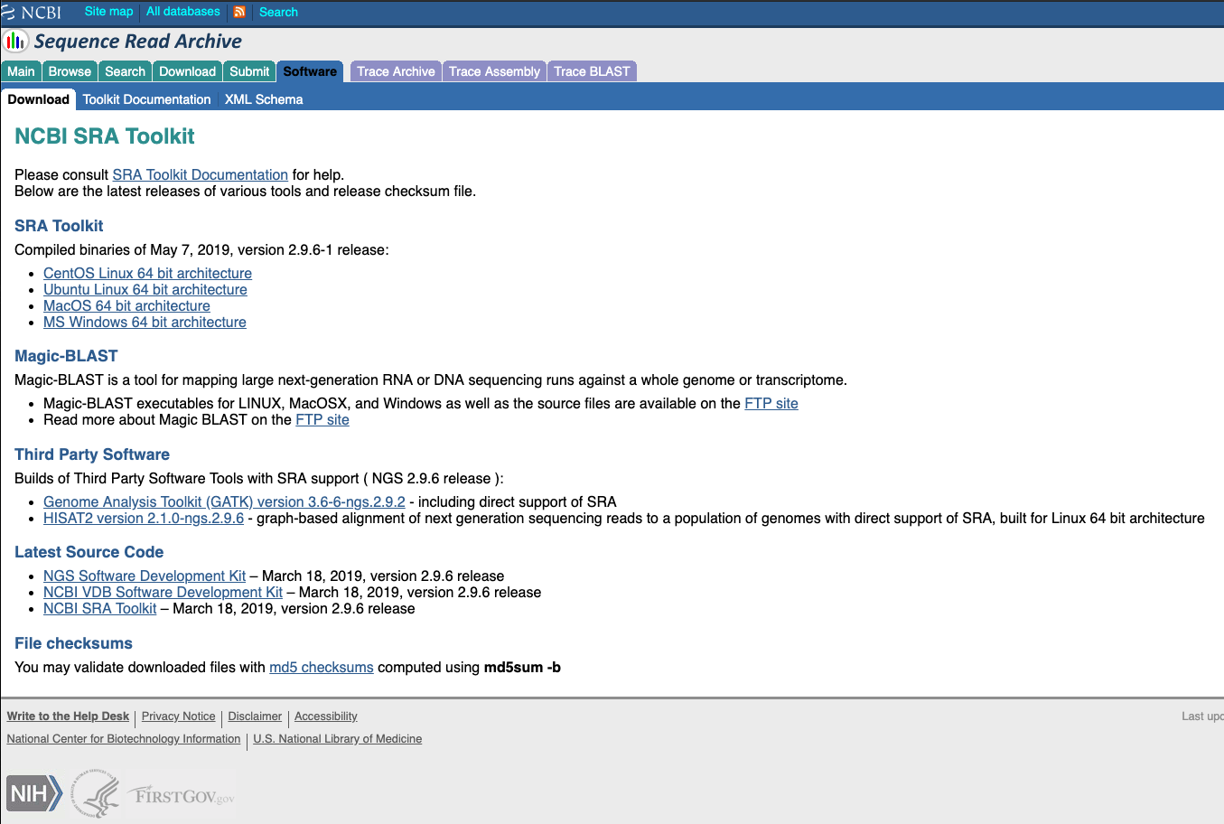

Slide 41
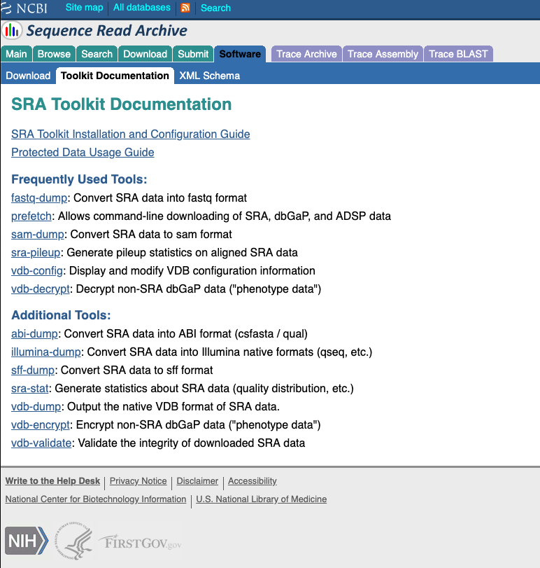

Slide 42
Using UNIX

Slide 43
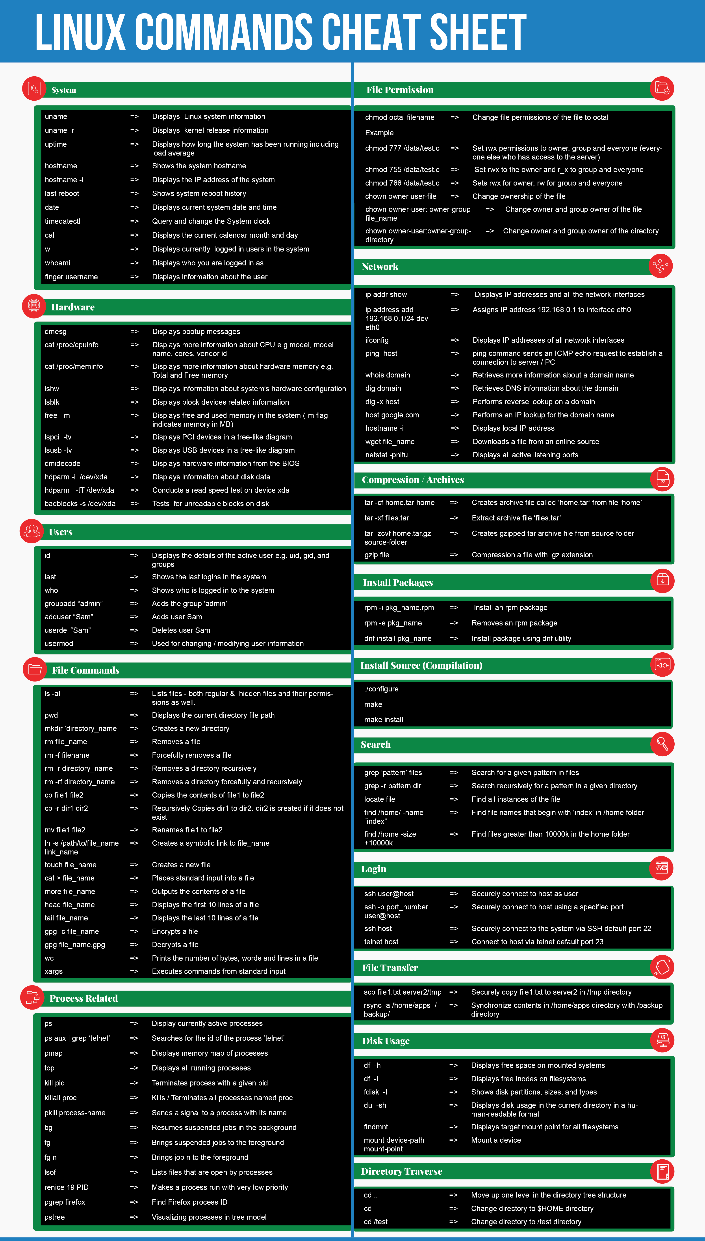

Slide 45
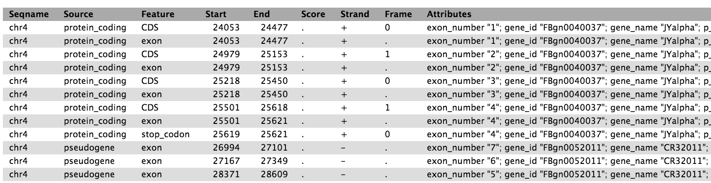

Slide 46
Using UNIX

Slide 47
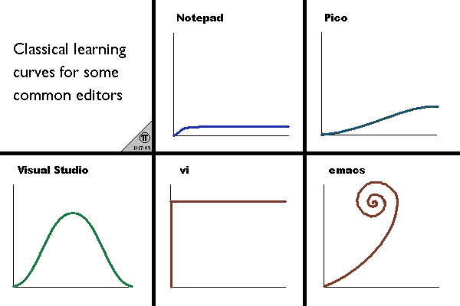
Using UNIX

Slide 48
Using UNIX
Word of Advice
Use a personal computer

Slide 49
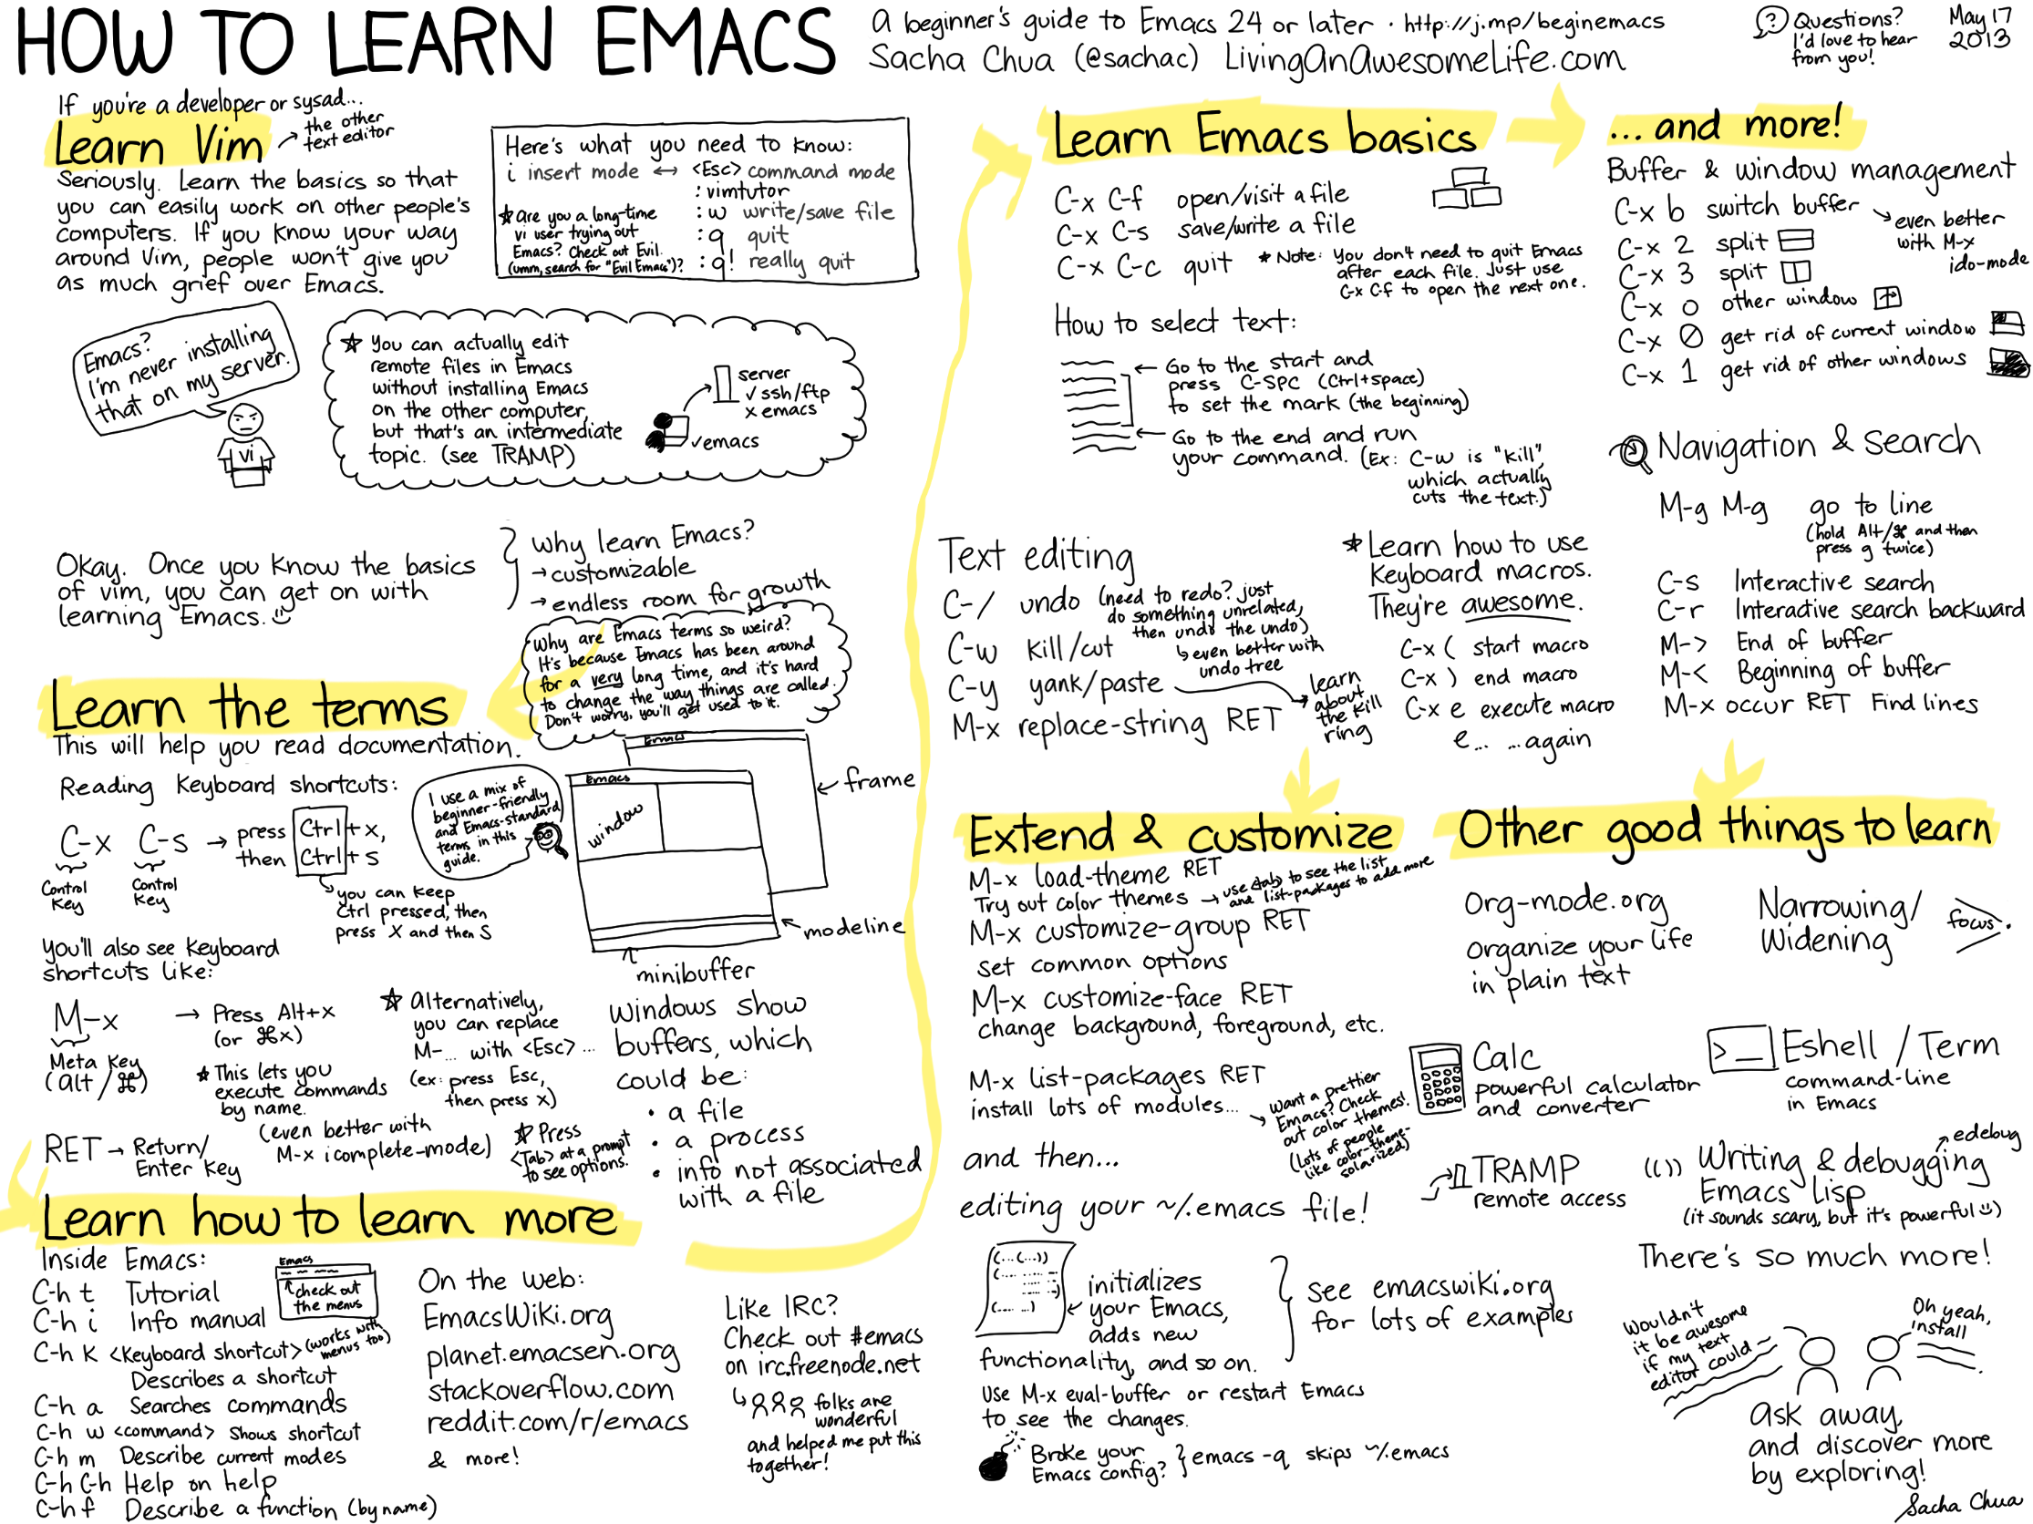
Using UNIX

Slide 50
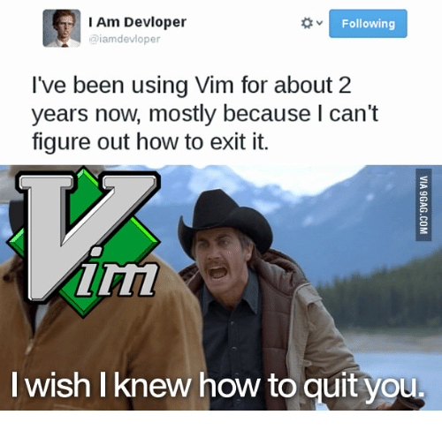
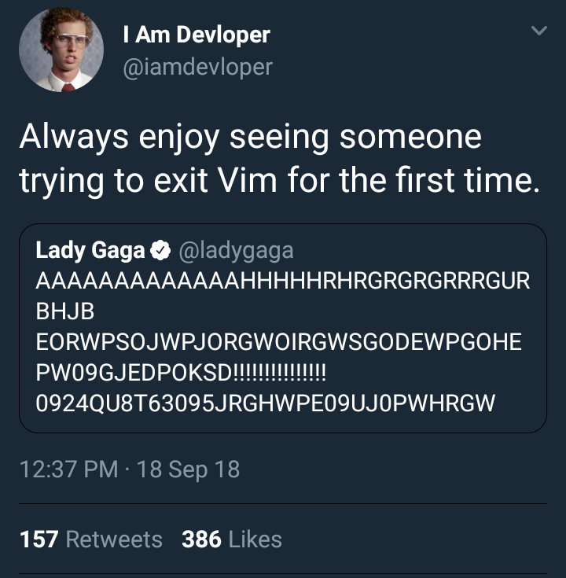

Slide 51
Sequencing: Files and Programs
UNIX/BASH
We need to talk about these files
R

Slide 52
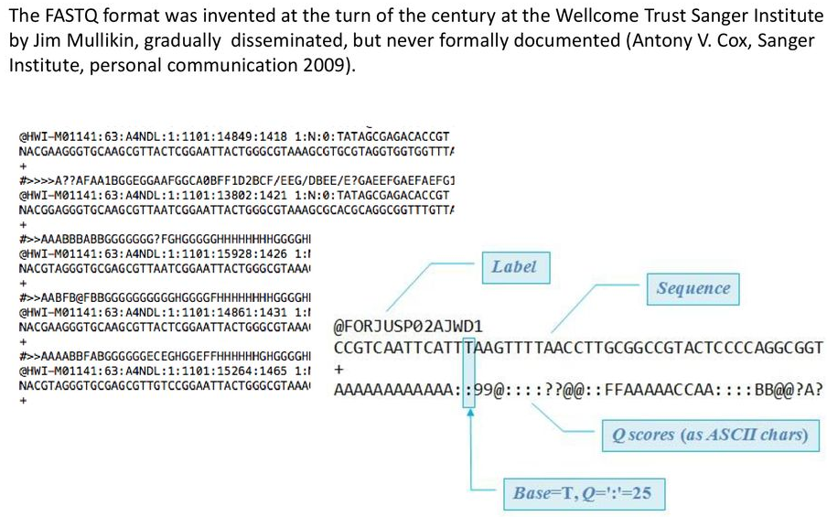
Fasta and Fastq for raw sequence data

Slide 53
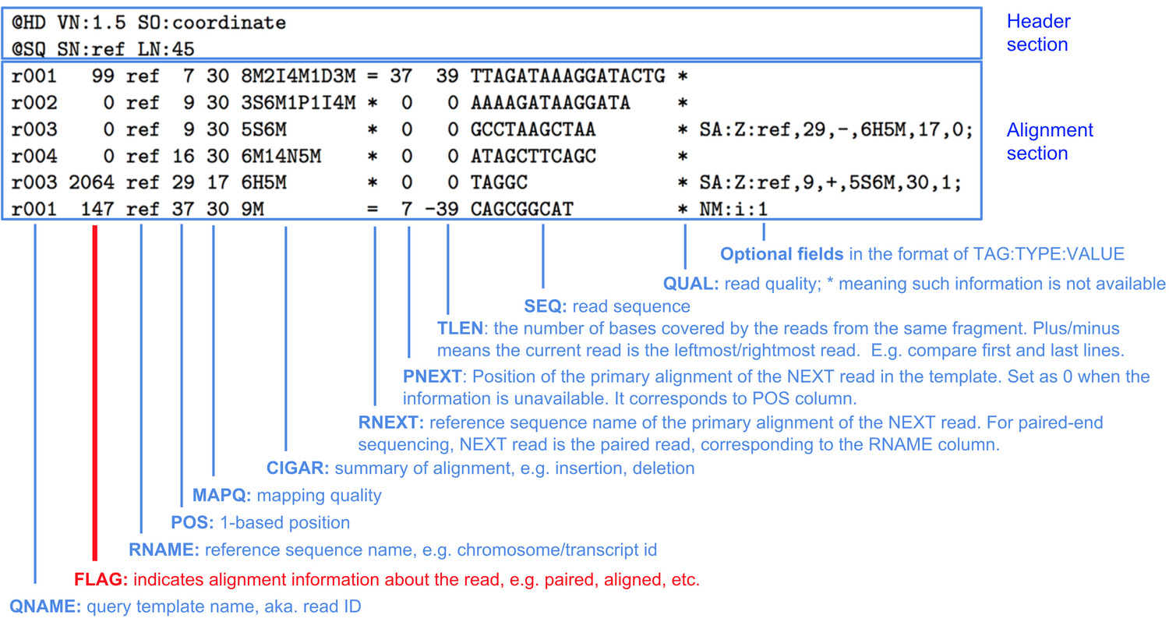
SAM and BAM for alignment data

Slide 54
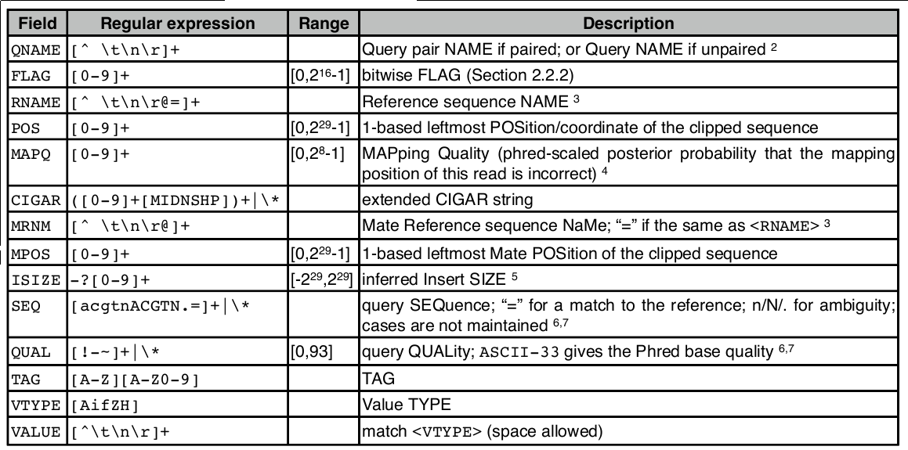
SAM and BAM for alignment data

Slide 55
GFF and GTF for genome annotations data

Slide 56
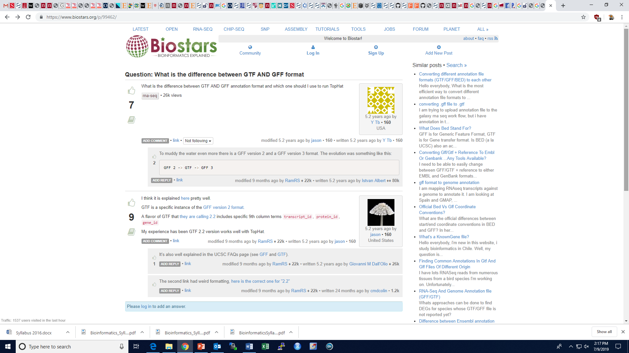

Slide 57
Scripting Languages
Student Coder
Professional Coder

Slide 58
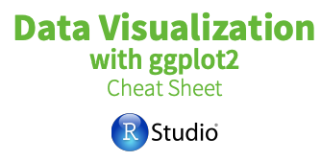
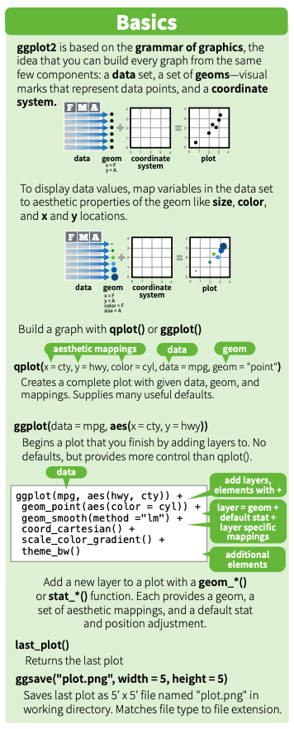
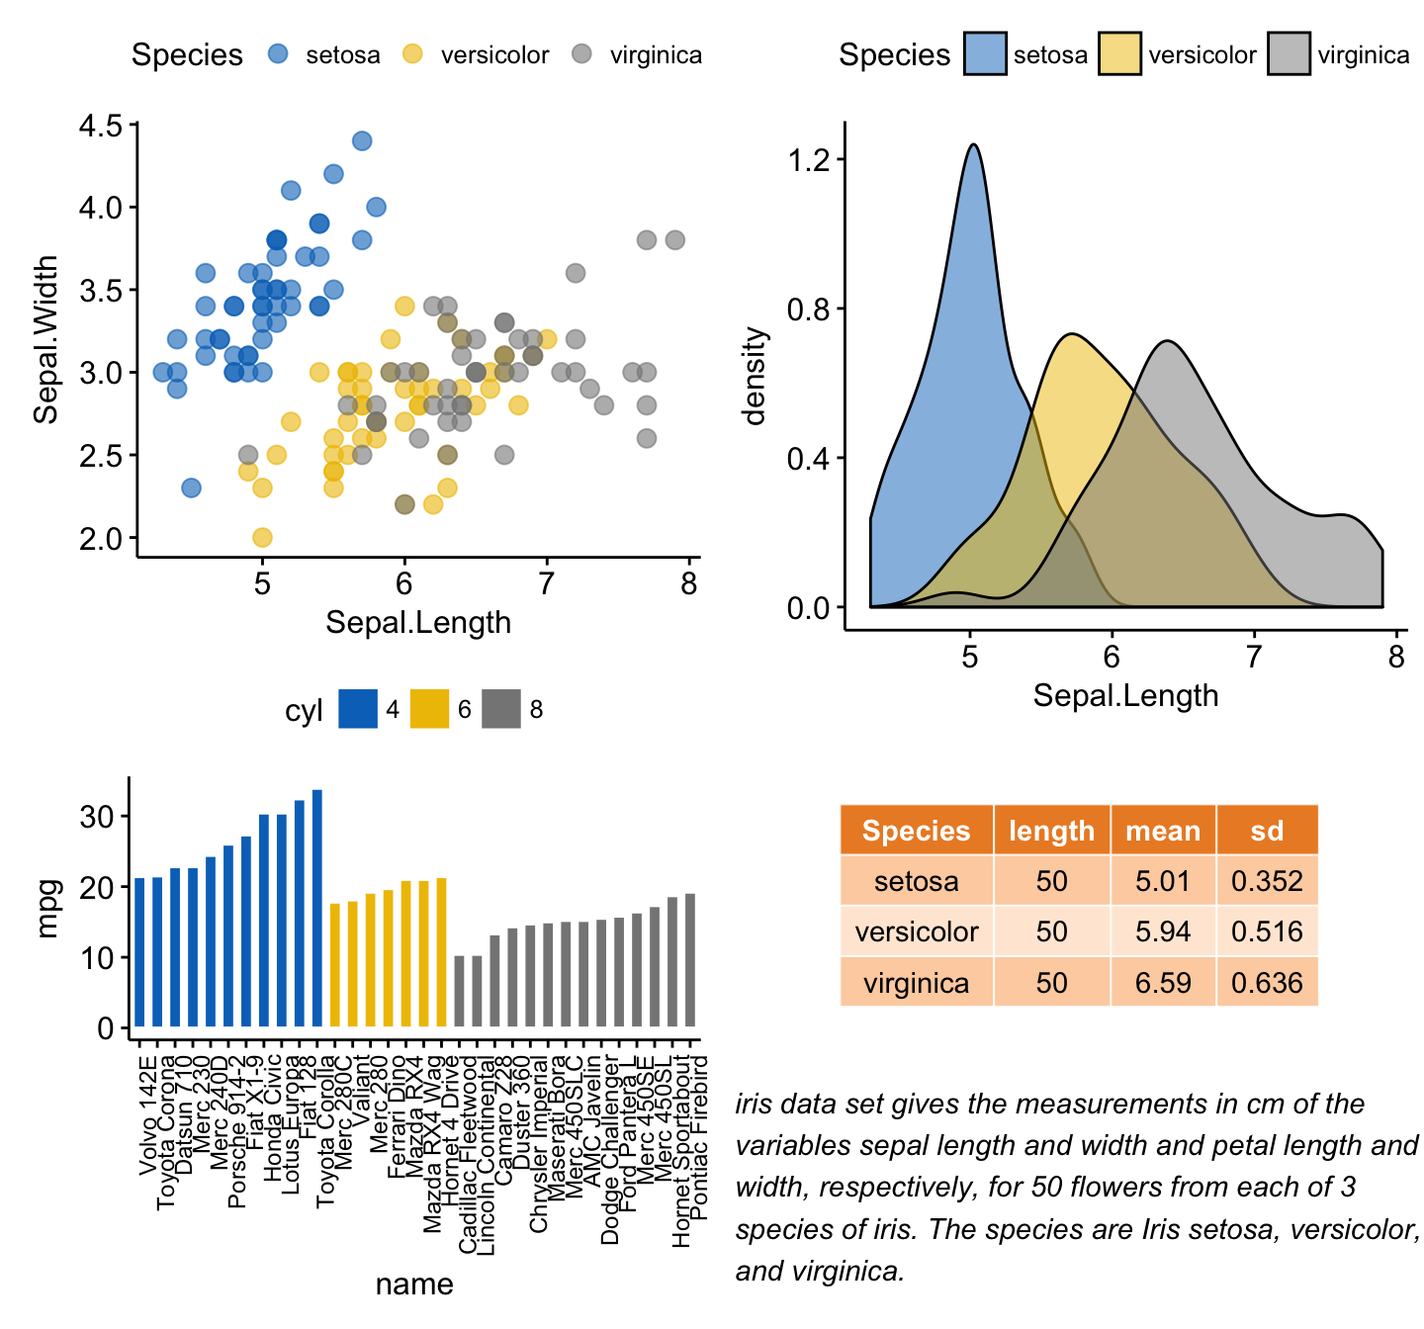
Data Visualization

Slide 59
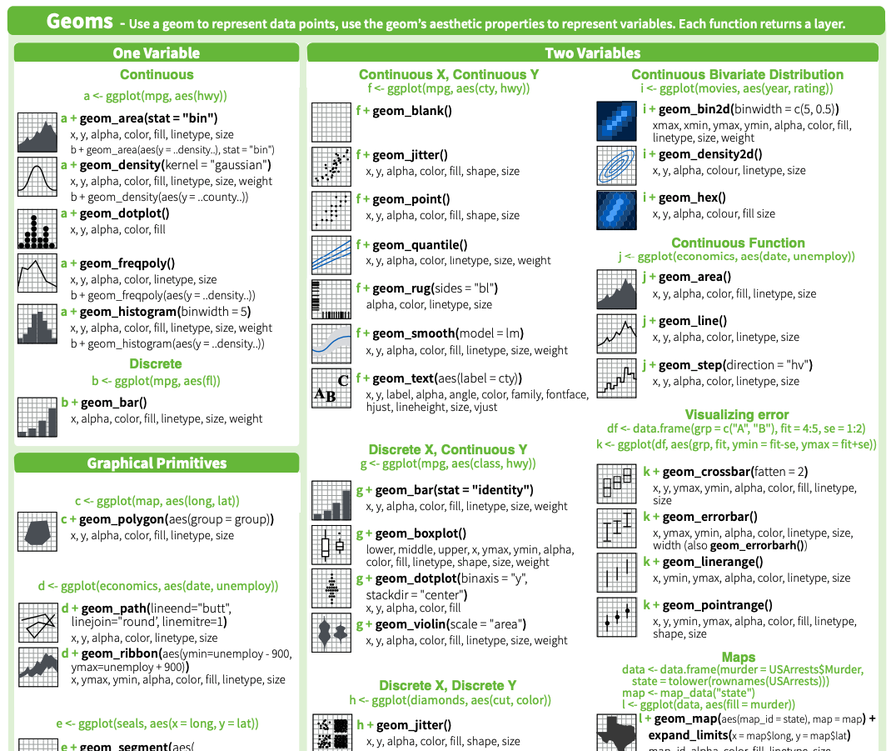

Slide 60
Data Visualization

Slide 61
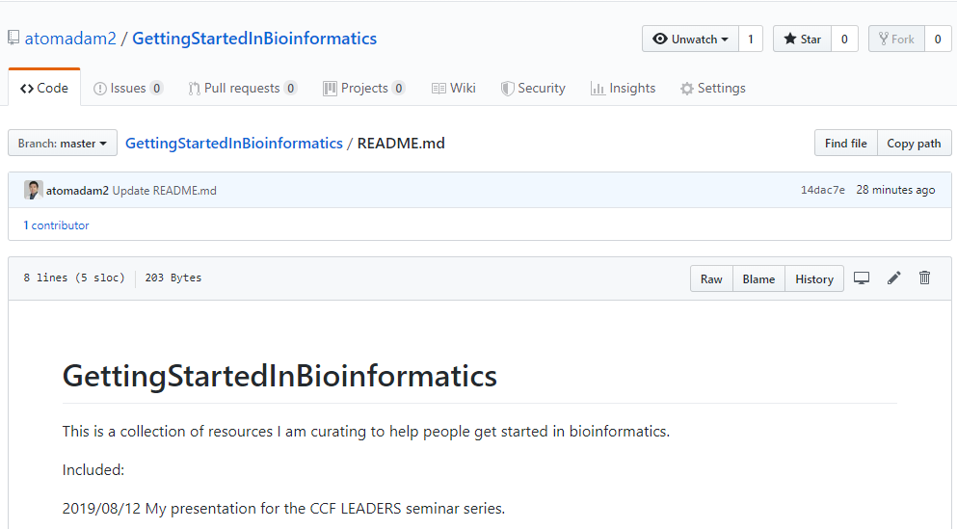
TWITTER AND GITHUB : @atomadam2

